Slide 1

Human Resources
David Hausmann
October 2005

Slide 2
Agenda
Employment
Compensation
Benefits
Employee Relations, EEO, Diversity
Field Human Resources
Employee Training and Organizational Development
Process & Change Management

Slide 3
HR Mission Statement
"We are committed to fully enable all of our employees in their primary mission, 'To protect those who protect us.' In order to accomplish this we will provide the leadership required for developing and implementing, in partnership with management, cost effective human resource systems, products and services necessary to develop and maintain a challenged, fairly treated, motivated, diverse and increasingly productive workforce."

Slide 4
HR Mission Statement (cont’d)
Leadership: To support senior management in ensuring that we have the Leadership in place at all levels, both now and in the future to enable the company's ongoing success.
Partnership/Customer Focus: To partner with our various stakeholders to help provide them with the services and products they need (customer focus) optimal success and compliance to achieve optimal success.
Talent Acquisition: To win the "war for talent" in order to ensure that we have the best people available, assigned to the right jobs... in a timely manner.
Enabling: To train and develop a workforce that has the skills, abilities, resources and tools, together with the authority, to optimally perform its respective accountabilities.

Slide 5
HR Mission Statement (cont’d)
Teamwork: To assist leaders in developing high performing organizations that deliver quality products and services through collaboration and teamwork.
Healthy Work Environment: To contribute to a healthy safe and secure environment which fosters wellness, openness, trust, enthusiasm, enjoyment, accountability and the ability to be forthright and honest with each other.
Continuous Quality Improvement (C.Q.I.): To continually measure and improve the quality and cost effectiveness of Human Resources programs and services to meet customer needs.

Slide 6
Employment

Slide 7
Responsibilities
Fill positions in a timely fashion
Fill positions in a cost effective manner
Identify, attract, and recommend the most qualified candidates
Stay on top of future hiring needs
Ensure company compliance with federal employment regulations

Slide 8
Guiding Principle
Literally every person we hire will impact in some way customer and community perceptions about BAE SYSTEMS

Slide 9
Costs of Recruiting
Employment
Staffing dept labor
Applicant Travel
Ads
Job Fairs
Open Houses
Signs
Internet Resume Databases and Postings
Manager Cost
Interview Time
“Casting Call”
Relocation
Agency Fees (25-30%)
Sign-on Bonus
Training
Assimilation

Slide 10
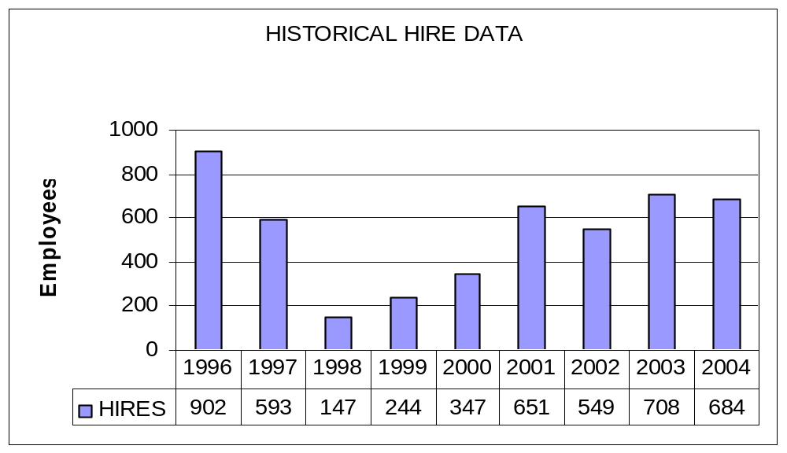
Historical Hire Data

Slide 11
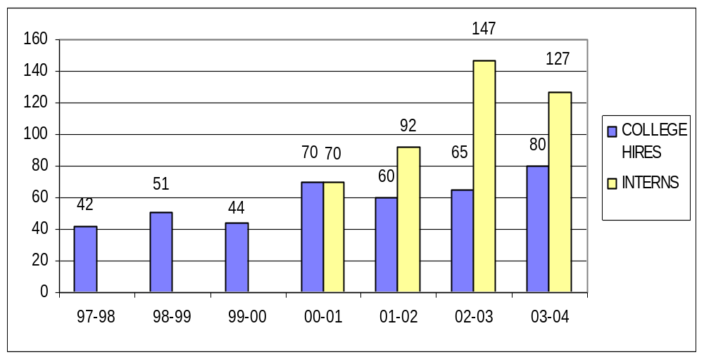
College Recruiting

Slide 12
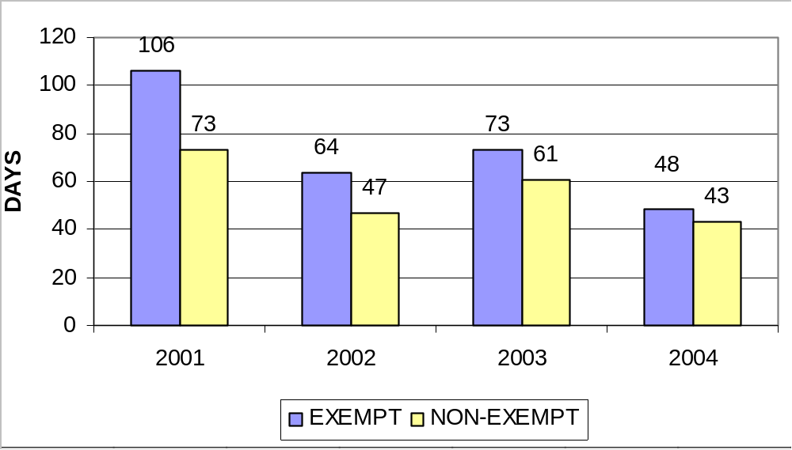
Time to Fill a Requisition

Slide 13
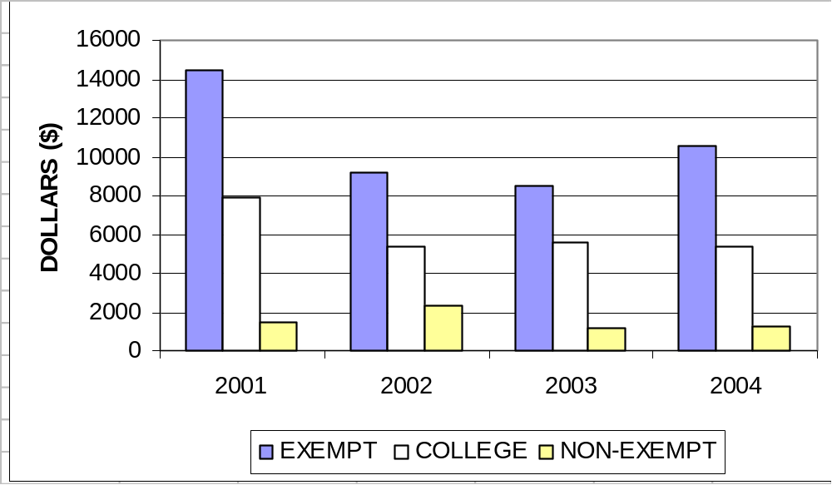
Employment Cost per Hire

Slide 14
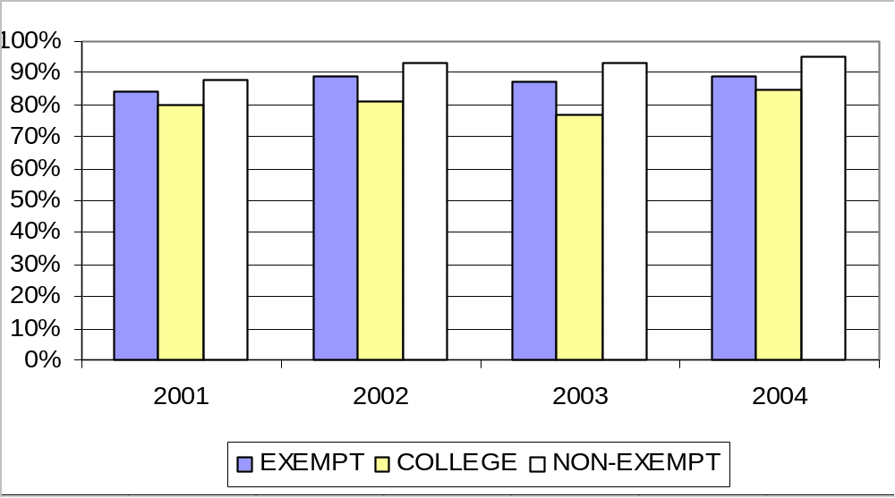
Offer / Acceptance Ratio

Slide 15
Legal Issues Surrounding the Hiring Process
Hiring Current & Former Government
Employees
Equal Employment Opportunity
Americans with Disabilities Act
Pre-employment Inquiries

Slide 16
Employment Policies
Employment - MDP 22.2
Employment of Former Military Personnel and Federal Government Employees. - MDP 22.3
Job Opportunities Program (JOP) - MDP 22.4
Pre-Employment Drug Screening - MDP 22.5
Intercompany Transfers - MDP 22.8
Hiring or Using Debarred or Suspended Individuals or Entities - MDP 22.9
College Intern - MDP 22.92

Slide 17
Compensation

Slide 18
Introduction to Compensation
Compensation - A payment of money for labor or services
Compensation Strategy
  Lead/Lag Philosophy
  Pay at market rate
Overall Payroll Budget- $503 Million (25% of Sales)

Slide 19
Compensation’s Role in Supporting Management
Determining a job’s worth
Establishing a promo, adjustment & merit budgets
Establishing & maintaining salary range structures
Communicating a salary action
  Merit
  Promo
  Adjustment
When and how to promote
Bonus Programs

Slide 20
Compensation’s Role in Supporting Management (cont’d)
Market Analysis
Maintain Market equity to reduce attrition and turnover
Manage Merit & Promo/Adj budget
  Promotes sense of value among employees
  Maintains competitive presence in job market
  Encourages career growth and opportunity, maintaining Employer of Choice appeal

Slide 21
Compensation’s Role in Keeping BAE Systems Competitive
Compensation Representatives attend training to stay up to date with industry
Participate in annual salary surveys to ensure salaries and salary structures accurately reflect market
Network with internal / external compensation professionals to ensure competitive practices
  BAE Compensation Working Group
  New England Compensation Consortium
  World at Work
  International Compensation Working Group

Slide 22
Employee Positioning
Thorough, accurate job descriptions to ensure job continuity through Business Units
Employees appropriately positioned in salary range to achieve maximum value for job based on market value
Salary ranges designed with midpoint for continuity of pay based on market data

Slide 23
Compliance Awareness
Fair Labor Standards Act
  Works in conjunction with Dept of Labor
Equal Employment Opportunity
Defense Contractor Auditing Agency
  Monitors Records and Processes
Record Maintenance
Awareness of audits, frequency

Slide 24
Shift Compensation
Administer shift differentials / premiums for off-shift workers and non-9/80 workers in accordance with labor laws.
Audit payment practices per MDP 22.57
  EWT
  On-Call
  Call-Back Time
  Weekend Shift

Slide 25
Incentive Pay Plans
Reward on-going performance in war for talent
  Technical Incentive Bonus Plan
  Special Recognition Awards
  Above and Beyond Awards
  All Employee Stock Appreciation Rights
  Annual Executive Compensation
  Employee Profit Sharing
  Miscellaneous Department / Team Awards

Slide 26
Reference MDPs
22.31 Base Compensation
22.35 Field Compensation
22.36 Per Diem
22.42 Extended work time
22.50 Service Dates
22.57 Work Schedules

Slide 27
Benefits

Slide 28
General Overview
Benefits administered through service center. Business Units responsible for helping set benefit strategy.
Benefits enhance the compensation package and attract and retain employees.
Benefits adds value to employee quality of life in addition to salary
  i.e. 9/80 work schedule & pay for time not worked

Slide 29
Components of Benefit Plan
Medical, Dental and Vision coverage for healthcare
Life Insurance Policies and AD &D
Pay for time not worked
  Vacation, Sick, Excused, Bereavement,
  Jury Duty, MLOA, STD, LTD
Tuition Reimbursement
Retirement Plans – Pension & 401K
  Vary by location and seniority
Miscellaneous benefits
  Holiday lunches, sporting event tickets, Holiday turkeys, Family Outings, Employee Services Discounts

Slide 30
Costing Benefit Plans
Medical costs rise each year!
  16-18% Annual Inflation in costs
Benefits dept must determine how much of healthcare costs can be absorbed by employees and still remain affordable and competitive each year.
  Benefits are a direct cost to DCMA
  $48 million in medical costs in 2004
NA determines plan design, BU’s determine personal costs per location
  2005 cost sharing was 90% employer, 10% employee

Slide 31
Compliance
HIPPA compliance dealt with through Service Center
Audits handled by individual locations but Service Center maintains employee records on Health and Welfare benefits

Slide 32
M & A Effect on Benefits
Upon acquisition of new companies, we must determine how to integrate the two benefit plans if applicable
  Different locations may have varying benefit plans determined by their market environment
Our Benefits group assists with support for E&IS OG acquisitions but does not directly administer

Slide 33
Retirement Education
Through comprehensive training seminars, educates employees of the retirement process through:
  Retirement process and steps
  Social Security Advisor
  Financial Planning advice
  Estate and Legal planning
Training given twice a year, as demanded
Goal is to educate employees ahead of retirement curve to ensure employees can retire at desirable age and quality of life

Slide 34
Reference MDPs
22.46 Paid Sick/Excused (Non-Exempt)
22.47 Paid Sick/Excused (Exempt)
22.51 Paid Holiday Time
22.52 Paid Vacation Time

Slide 35
Employee Relations

Slide 36
Role of Employee Relations
Culture (Policies)
Performance Management
Diversity, EEO, and Affirmative Action
Legal Compliance
Employee Satisfaction & Retention
Dispute Resolution
Employee Assistance
Community Involvement
Legislative Liaison

Slide 37
Employee Relations
Process Owner For:
Policy Development and Implementation
Compliance With Employment Statutes
Employee Satisfaction and Wellness
Affirmative Action
and Diversity
Layoff Selection
New Employee Orientation
BECFI
Alternative Dispute Resolution
EAP

Slide 38
How ER impacts business success
Provide policy interpretation to HR and management
Help identify risk & provide counsel
Provides consistency in disciplinary actions
Last point of appeal for grievances
Orients new employees
Investigates employment law complaints
Represents Company at Unemployment, WC, and Employment Discrimination Hearings

Slide 39
Performance Management Process
STRATEGIC &
OPERATIONAL
PLANNING
SUCCESSION
PLANNING
SETTING
OBJECTIVES
PROMOS
CONTINUOUS
COACHING &
FEEDBACK
MERIT
DELIVERY
PERFORMANCE
APPRAISAL
CORRECTIVE
ACTION & DISCIPLINE
LAYOFF
SELECTION
TERMINATION

Slide 40
Equal Employment Opportunity & Affirmative Action

Slide 41
Equal Employment Opportunity
Means that essential qualifications necessary to do the job right must be the only consideration in hiring, training, promoting, and managing personnel.
Means that employees cannot be discriminated against due to race, color, age, sex, religion, disability, national origin, or veteran’s status.
Applies to all areas of employment, including job assignments, benefits, discipline, training and development, pay, promotion, and termination.

Slide 42
Discrimination Statutes
Civil Rights Act of 1964, 1991 (Title VII)
Age Discrimination in Employment Act (ADEA)
Americans With Disabilities Act (ADA)
Equal Pay Act (EPA)
Federal Pregnancy Discrimination Act
Whistleblower Protection
Various State Law Protections

Slide 43
Affirmative Action
Positive action plans the company makes to ensure Equal Employment Opportunity, to seek out qualified people from underutilized segments of our society, and to allow them to compete for jobs or to advance on the basis of merit, ability, and potential.
Is mandated by Executive Order 11246 for government contractors. Requires federal contractors to take positive steps toward eliminating the present and future effects of past discrimination against women and ethnic minorities.
We must have a plan which demonstrates our actions in hiring and advancing women, minorities, people with disabilities, disabled veterans and Vietnam Era veterans.

Slide 44
Office of Federal Contract Compliance Programs
DOL regulatory agency
Conducts compliance evaluations
Investigates claims
Directs monetary settlements
May delay contract awards

Slide 45
Diversity

Slide 46
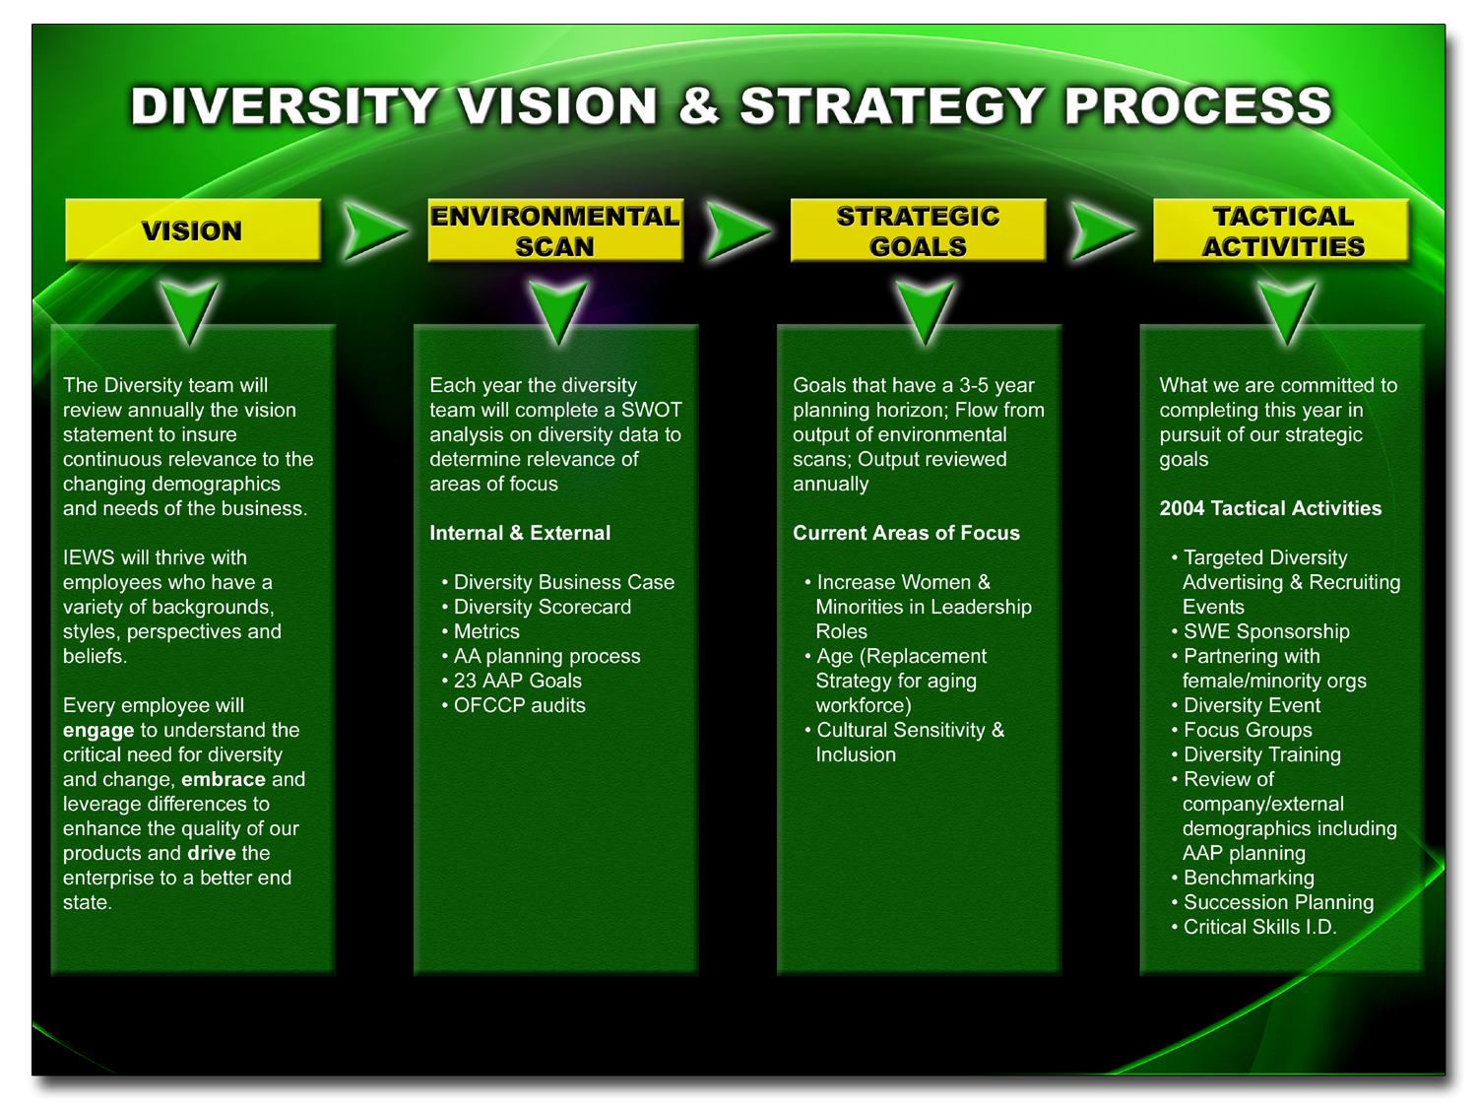

Slide 47
ER Statistics Tracked
Worker’s Comp, Indemnity, and Medical Claims
Involuntary Separation Rate
Exempt = (37) 3.27%
NonExempt = (27) 3.59%
All = (64) 3.36%
Voluntary Separation Rate
Exempt = (83) 2.49%
NonExempt = (23) 1.72%
All = (106) 2.27%
Annualized as of 9/30/05

Slide 48
Reference MDPs
22.20 - Standards of Conduct
22.12 - Prohibition Against Harassment/Sexual
Harassment
22.97 - Family and Medical Leave of Absence
22.10 - Equal Employment Opportunity
22.19 - Workplace Violence
23.9 - Right to Access Computer, Network
25.3 - Personal Use of Computer/Network Assets

Slide 49
Field Human Resources:
Client Facing

Slide 50
Responsibilities
Add strategic value by linking HR practices to the business strategy resulting in competitive advantage for the enterprise.
Partner with Business and/or Function to deliver HR programs leading to a successful work environment
Broker HR services provided by HR functions such as employment, training and development, compensation and benefits.
Employee advocate

Slide 51
Areas of focus
Partner with management to deliver HR programs such as:
  Performance Management
  Employee Satisfaction Surveys
  Resource Planning Actions
  Crisis Management Team actions

Slide 52
Areas of Focus
Coordinate delivery of other HR Programs
  Compensation Programs
  Team Incentive Programs
  State of Mind Training
  Succession Planning
  Organizational Development
  Broad-based Training and Development Needs

Slide 53
Areas of Focus
Maximizing business effectiveness by working with managers and employees
  Assessing communication needs
  Coaching managers and employees for success
  Driving organizational change
  Culture management
  “Eyes and Ears” – employee advocate
  Investigations

Slide 54
Performance Management
Annual Performance Review Process
  Performance Assessment Review (PAR)
    Non Performance Centered Leadership (PCL) and Non exempt
  Performance Development Review (PDR)
    PCL
Performance Improvement Process
  Initial Performance Improvement Discussion (verbal)
  Corrective Action Plan (CAP)

Slide 55
Employee Satisfaction
Tools to assess the work environment to help define areas of focus of senior management in achieving and maintaining a world class environment.
  Surveys
    North America Employee Opinion Survey
    E&IS Pulsing Survey
  New Hire Interviews
  Exit Interviews
  Skip Level/Town Meetings
  New Manager Assimilation

Slide 56
Resource Planning
Long term and short term plans
Hiring Critical Skills
Employee Retention
Reduction in Force (RIF)

Slide 57
Adding Value
Human Resources has impact on business success by
  Minimizing risk
  Using statistics to analyze trends
  Identifying potential future problems and possible solutions
  Provide policies to support a world class work environment.

Slide 58
Employee Training and Organizational Development

Slide 59
Employee Training and Organizational Development
ETOD assesses, develops, conducts, evaluates, and continuously enhances the quality of education, training and organizational development programs and services to anticipate and respond to company needs.

Slide 60
Employee Training and Organizational Development
These efforts aim at producing a sustained cadre of competent professionals, Managers/Leaders, and teams who consistently bring out the best in themselves and others.

Slide 61
Leadership and Management Development
WHAT?
Executive Institutes
Executive Coaching
Management Courses (M4P, etc.)
WHY?
A significant relationship exists between leadership development efforts and financial success
Healthy leaders create healthy and inspired work environments, leading to optimal work performance
People join companies and leave management

Slide 62
Succession Planning
WHAT?
Identification of back-ups and High Potentials for senior leadership positions
Working with Business Area management, succession plans are updated and tracked quarterly
Comprehensive change-management tool that helps E&IS identify and fill talent gaps
WHY?
Aligns business goals with human capital needs
Addresses aging senior management population and ensures continuity of effective leadership
Ensures E&IS has the leadership needed to function at peak efficiency

Slide 63
Organizational Development
WHAT?
Strategic Planning - Vision, Mission, Roles, Critical Success Factors
Organizational Structure
State of Mind Awareness
Individual and Team Dynamics, including Organizational Interventions
Leadership/Management
Individual and Team Assessments and Surveys
WHY?
People (the “Human Factor”) are the key to our success
OD consultants help create world-class environments where people can work at an optimal level
OD Consultants assist management in creating aligned organizations and teams. (Strategy, Structure, Systems, Skills, Shared Values, Leadership, etc.)

Slide 64
Tuition Assistance
WHAT?
Tuition assistance covers tuition, required course textbooks and some course fees, such as registration and lab fees
WHY?
To help employees reach their highest potential
Enhances employee job knowledge and effectiveness
Additional knowledge and effectiveness is transferred back to our business
Assimilation and retention of qualified employees

Slide 65
Engineering/Program Management Training
What?
S.T.E.P
Program Manager Professional Development Program (based on PMI body of knowledge)
Extensive PM and Engineering courses
Management of Technology Master’s Program- UNH
Systems Engineering Master’s Degree- JHU
WHY?
Provides Program Managers and Engineers with the skills necessary to execute our business objectives
Ensures we meet compliance standards for CMMI and other audits

Slide 66
Manufacturing Training
WHAT?
Solder
  Terminals, PC Boards, Surface Mount, Rework, Inspection
ESD
FOD
Route Card
WHY?
We train our operators to manufacture to specification, allowing us to meet customer requirements

Slide 67
Learning Management System
WHAT?
BAE SYSTEMS Learning and Development Network (L&D Net)
www.bae.click2learn.com
WHY?
Provides “one-stop shop” for all online training and registration needs
Allows employees to see courses offered all over NA
Automates the registration process

Slide 68
ETOD - Summary
The work of ETOD helps employees perform better, in a challenging and exciting work environment that guarantees customer satisfaction and associated company growth and profitability.

Slide 69
Reference MDPs
22.89 Instructor Compensation
22.90 Job Qualification and Training Process
22.91 Tuition Assistance

Slide 70
Process and Change Management

Slide 71
HR Process and Change Management
Assures that Human Resources has a set
of strategically focused, tactically
integrated and cost efficient functional
processes, systems and procedures.

Slide 72
HR Process and Change Management
Direct HR strategic planning and change management activities
  Ensure the HR function is providing its customers with services and programs that satisfy or exceed their quality expectations
  Coordinate strategy with other functional HR leaders

Slide 73
HR Process and Change Management
Manage the HRIS function
  Identify requirements for new applications and systems
  Develop preliminary system design
  Prototype and test application
  Recommend enhancements
  Coordinate with CSC the final design, development, testing and implementation of new systems and applications to support HR and the business area

Slide 74
HR Process and Change Management
Plan process redesign through use of lean thinking principles
  Coordinate process design, development, and implementation
  Assess and manage risk
  Identify and evaluate best practices
  Facilitate development of required strategy, structure, systems, processes, tools and resources

Slide 75
HR Process and Change Management
HR Metrics/MSPA Objectives
  Coordinate the development and collection of HR metrics,
  Manage quarterly metric reviews and audit compliance process.
  Coordinates the development and collection of HR Mission Success Objectives
  Manage the monthly reporting of results to the Mission Success organization.

Slide 76
HR Process and Change Management
POC to other Organizations on Projects of Mutual Interest
  Maintain contact with other organizations’ project team representatives at various levels of responsibility
  Make recommendations to inter-organization management regarding organization policies and procedures.

Slide 77
Summary
“When business organizations create the right kind of environment, ordinary people can create extraordinary value to support customers and stockholders.”
-Larry Teverbaugh, Westinghouse

Slide 78
Summary
Human Resources provides programs and initiatives that develop and maintain a challenged, fairly treated, motivated, diverse and increasingly productive workforce
HR helps manage human capital, our company’s biggest investment
This human capital executes our business objectives and creates a competitive advantage for BAE SYSTEMS

